Slide 1
TSDS Introductory Series:
PEIMS

Slide 2
Contents
Why is our data collection system important?
Limitations of current PEIMS data collection system?
What is TSDS?
How will TSDS work?
Will TSDS replace PEIMS?
How will TSDS PEIMS help LEA customers?
How will TSDS PEIMS help TEA customers... and beyond?
When will it be implemented?
Where do we go from here?

Slide 3

Presentation Objective
Provide an overview to TEA staff about the new Texas Student Data System (TSDS) that will be available to all school districts and charter schools across the state.

Slide 4
CONTENTS
Why is our data collection system important?
Limitations of current PEIMS Data Collection System?
What is TSDS?
How will TSDS work?
Will TSDS replace PEIMS?
How will TSDS PEIMS help LEA customers?
How will TSDS PEIMS help TEA customers... and beyond?
When will it be implemented?
Where do we go from here?

Slide 5
Why is our data collection system important?
State-mandated PEIMS
Reporting
TPEIR
AEIS
Snapshot Reports
Accountability System
Other Public Reports
Key Take Away: PEIMS data is integral to TEA meeting its state and federally mandated functions.
Note: Above data is provided via MainPRD and PID
Notes:
It feeds many TEA program areas, including:
It provides longitudinal data that we need in order to improve student educational achievement and to align with US ED best practices

Slide 6
CONTENTS
Why is our data collection system important?
Limitations of current PEIMS Data Collection System?
What is TSDS?
How will TSDS work?
Will TSDS replace PEIMS?
How will TSDS PEIMS help LEA customers?
How will TSDS PEIMS help TEA customers... and beyond?
When will it be implemented?
Where do we go from here?

Slide 7






Current PEIMS Data Collection
Heavy financial & resource burden on LEAs
Limited data returned to LEAs
All LEAs load during limited quarterly windows
Received too late, insufficiently granular
Limited validations up front
Limited usefulness for adjusting instruction
LEAs must reload entire data set repeatedly until data is clean

Slide 8

TEA Responsibilities to LEA Customers
Achieving performance goals
Driving down costs
Helping customers meet compliance
We’re asking more from our educators at a time when resources are scarce.
Notes:
Achievement – Educators and administrators need tools to improve graduation rates, test scores, and college readiness
Cost – LEAs need systems that are inexpensive, quick to learn, and efficient to use.
Compliance – Administrators need to comply with state reporting requirements as efficiently and accurately as possible, with minimal drain on staff time

Slide 9

EDIT+ Limitations for LEA Customers
Achievement
PEIMS data in its existing format is not useful for teachers
Cost
The current EDIT+ PEIMS system is cumbersome and inefficient, consuming staff hours

Slide 10
EDIT+ Limitations for LEA Customers
Compliance:
PEIMS coordinators have approximately a 2-month window to load each collection.
Limited validations mean coordinators may load one collection dozens of times.
While EDIT+ can only run on Internet Explorer, some SISs can only run on other browser platforms, so PEIMS loaders and coordinators have to switch back and forth
Processing PEIMS data is expensive in time and resources.

Slide 11

Challenges for TEA
Cost & Maintenance:
  Adding new data fields to the legacy system is expensive and time-consuming (est. $80K/field).
  The ~160 separate TEA data collections are costly to the state.
Obsolescence: EDIT+ is incompatible with most commercial systems currently available on the market.
Unstable System: Due to volume of data, EDIT+ frequently crashes during PEIMS submissions.
  Data Volumes: 11GB/year over 142M rows, submitted and resubmitted in different versions, resulting in TEA processing 2.5 billion rows of data.
Notes:
The resource we have is????
Data!

Slide 12
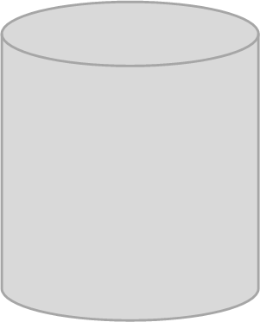

Dramatic Increase in PEIMS Volume
330% increase in PEIMS data elements 1987-2012
50M rows of data added
2007/08 – 2011/12
143 million
2011/12
178 data
elements
2012
93 million
2007/08
54 data
elements
1987
Notes:
TEA collects some identical data multiple times from LEAs for various mandated collections.
PEIMS technology is outdated and becoming more and more costly to maintain to TEA and LEAs.
Increased data volumes annually cause outages to current PEIMS production platform.

Slide 13
CONTENTS
Why is our data collection system important?
Limitations of current PEIMS Data Collection System?
What is TSDS?
How will TSDS work?
Will TSDS replace PEIMS?
How will TSDS PEIMS help LEA customers?
How will TSDS PEIMS help TEA customers... and beyond?
When will it be implemented?
Where do we go from here?

Slide 14
TSDS Vision
TSDS will:
Modernize the PEIMS data collection process to reduce technology risk and system downtime, allowing for more system availability and ease of use, and;
Put real-time student performance data in the hands of educators to improve student achievement, and;
Become the one common data collection platform for TEA to reduce the data collection burden on districts and charter schools.

Slide 15
TSDS: 4 Key Projects
• The State-sponsored Student Information System (SSIS) is a software as a service (SaaS) master contract negotiated by TEA with TCC TxEIS and Skyward to reduce price and improve functionality for participating district and charter schools.
• Will become conduit to submit PEIMS data.
• Loading of non-PEIMS data is strictly optional and at the LEAs’ discretion.
• System supported by TEA, but the data only available to educators.
• Powers StudentGPS™ Dashboards.
• TSDS PEIMS leverages the benefits of the new TSDS platform through a redesign of the state-mandated PEIMS process. TSDS PEIMS collects public school data to help determine funding allocations, accountability ratings, and facilitate data reporting for state and federal initiatives.
• TPEIR is the statewide longitudinal data warehouse that combines 20+ years of data from Texas public schools, higher education, educator certification and the workforce. The public-facing reports support analysis of students moving from PreK-12 to Texas colleges and universities, and in some cases, return to PreK-12 as teachers or administrators.
State-sponsored SIS
Education Data Warehouse
PEIMS
TPEIR

Slide 16
CONTENTS
Why is our data collection system important?
Limitations of current PEIMS Data Collection System?
What is TSDS?
How will TSDS work?
Will TSDS replace PEIMS?
How will TSDS PEIMS help LEA customers?
How will TSDS PEIMS help TEA customers... and beyond?
When will it be implemented?
Where do we go from here?

Slide 17




Introducing TSDS
Comprehensive reports
Research-based metrics & reports
Partial data loads reduce errors, limit burden on system
Student-level, updatable daily
LEAs load data at will
New pre-K, assessment, & workforce data
More validations up front = cleaner data sooner

Slide 18
CONTENTS
Why is our data collection system important?
Limitations of current PEIMS Data Collection System?
What is TSDS?
How will TSDS work?
Will TSDS replace PEIMS?
How will TSDS PEIMS help LEA customers?
How will TSDS PEIMS help TEA customers... and beyond?
When will it be implemented?
Where do we go from here?

Slide 19
Will TSDS Replace PEIMS?
Mostly:
The PEIMS Data Mart (PDM) will replace EDIT+, but the existing longitudinal PEIMS database housed in Main_PRD will continue to be used.

Slide 20
Main_PRD Unchanged
This process will NOT change!

Slide 21
CONTENTS
Why is our data collection system important?
Limitations of current PEIMS Data Collection System?
What is TSDS?
How will TSDS work?
Will TSDS replace PEIMS?
How will TSDS PEIMS help LEA customers?
How will TSDS PEIMS help TEA customers... and beyond?
When will it be implemented?
Where do we go from here?

Slide 22


Meeting LEA Customer Needs
Achievement
The dashboards are designed to provide tools to monitor, assess and take needed steps to enhance student performance to help teachers be more effective.
TSDS puts vital information into one easy-to-use dashboard, so teachers save time by not having to search multiple sources for student data.

Slide 23

Meeting LEA Customer Needs
Cost
TSDS will provide detailed standards and a more streamlined process for TEA and agency data collection efforts, ultimately reducing time while improving overall data quality.

Slide 24

Meeting LEA Customer Needs
Compliance
All submissions for the current school year will be open from the first day of school to help PEIMS coordinators identify and correct errors earlier in the process.
TSDS offers a new client-side validation tool available throughout the process, which will help identify data errors earlier, prior to loading PEIMS and dashboard data to the Education Data Warehouse (EDW)—ultimately enhancing data quality in the long-term.

Slide 25
CONTENTS
Why is our data collection system important?
Limitations of current PEIMS Data Collection System?
What is TSDS?
How will TSDS work?
Will TSDS replace PEIMS?
How will TSDS PEIMS help LEA customers?
How will TSDS PEIMS help TEA customers... and beyond?
When will it be implemented?
Where do we go from here?

Slide 26
Meeting Internal Customer Needs
Cost-effective:
  TEA will be able to add new fields to XML-based data collections more cheaply and easily.
  TSDS will become the one common data collection platform for TEA, thus reducing time and money spent on the current 160 separate data collection requests.
Up-to-date:
  TSDS uses popular, up-to-date technology that is easier to maintain.
Stable:
  TSDS PEIMS is designed to improve our system capacity, which will reduce technology risk (including system downtime) that was present with EDIT+.
Notes:
The resource we have is????
Data!

Slide 27
Meeting Program Area Needs
Expandable: Can add new data fields easily and include other TEA
collections into TSDS, upgrading those systems (some data is currently collected via spreadsheet, for example)
Seamless: Program areas’ access to their data will not change
Improved data quality:
  A new statewide TSDS identifier: Unique ID
  More validations available to LEA users throughout process
  Long-term goal: a single consistent data source for all data collections

Slide 28











Benefits Ripple Out to Many Different Groups
Leaving Main_PRD intact saves TEA program areas money
More money available for student programs
Student performance improves
Saves LEAs money
Better reporting options help teachers keep
parents involved
Cost Effective
Better data improves reporting to TEA
Students benefit from data-informed pedagogy
Superintendents can track LEA progress with up-to-date data
Intuitive system eases strain on TEA support staff
Teachers can identify & address problems early
Saves administrators
& LEAs time
Better Data
Saves teachers time, helps them get more
out of data
Easy to Use

Slide 29
CONTENTS
Why is our data collection system important?
Limitations of current PEIMS Data Collection System?
What is TSDS?
How will TSDS work?
Will TSDS replace PEIMS?
How will TSDS PEIMS help LEA customers?
How will TSDS PEIMS help TEA customers... and beyond?
When will it be implemented?
Where do we go from here?

Slide 30
How do we roll out to 1,237 LEAs?
A phased approach:
  7 Districts will be involved in Limited Production Releases (LPRs), of which 5 are currently in production (Lubbock, Allen, Pharr-San Juan-Alamo, Hays, Taylor).
  Early adopter districts will be put into production during 13/14 school year, and will perform parallel submissions in the new and legacy systems.
  There is an expected 3-year phase-in: school years 14/15, 15/16, and 16/17.
NOTE: TEA will operate both EDIT+ and TSDS during 3-year phase-in—both systems will feed Main_PRD. For early adopter districts, EDIT+ will be the official PEIMS submission system, with TSDS PEIMS as a test.

Slide 31
TSDS Statewide Implementation Timeline
2014
Late-2009
2010
2011
2012
2013
Draft data snapshots defined
Snapshots finalized based on feedback
Stakeholder engagement
Draft data standard defined
Transfer tested data standard
Initial EDW prototype
Limited Product Release Phase
Statewide implementation of EDW, PEIMS, and dashboards
Field test and acceptance of data standard
Unique ID, TEAL, Portal
Education Data Warehouse (EDW) Implemented
State-Sponsored SIS requirements released
Integrate
SSIS and EDW

Slide 32
CONTENTS
Why is our data collection system important?
Limitations of current PEIMS Data Collection System?
What is TSDS?
How will TSDS work?
Will TSDS replace PEIMS?
How will TSDS PEIMS help LEA customers?
How will TSDS PEIMS help TEA customers... and beyond?
When will it be implemented?
Where do we go from here?

Slide 33
What are future opportunities for TSDS?
Add new data marts
Incorporate other TEA data collections
NEW
NEW
NEW
Notes:
Medium-term (Utilizing TSDS data for other collections)
All student-level data collections – Dept: Federal and State Education Policies
Highly Qualified (Teachers ) – Dept: Educator Initiatives
Principal surveys on 1st, 2nd, and 3rd year teachers – Dept: Educator Standards and Certification
PMI monitors for Leaver Records, Discipline, and Student Assessment – Dept: Program Monitoring and Interventions
Financial Data – Dept: Financial Audits
Monthly staff data and charter school attendance reports every six weeks – Dept: School Finance
Longer-term
Include most or all remaining TEA-mandated collections in TSDS (~160 collections)
*From Deloitte’s “TEA and ESC TSDS Survey Results”

Slide 34
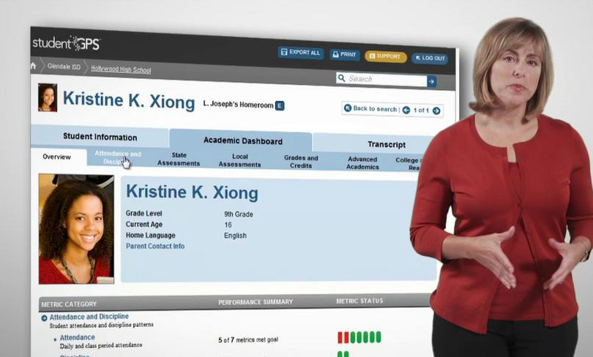
Demonstration of Dashboards: Overview
http://vimeo.com/47511948

Slide 35
Questions?
www.TexasStudentDataSystem.org

